Slide 1


Aman: Emergency Medical System for Palestine
Smart Web & Mobile Solution for Wartime Ambulance Coordination

Slide 2
Project overview
The Aman System is a modern emergency response platform designed for wartime conditions in Gaza. It consists of:
A web-based control system for the Palestine Red Crescent Society (PRCS)
A mobile app for civilians to request ambulances with one tap
The goal is to save lives through smarter, faster ambulance dispatch, even under extreme conditions.

Slide 3
Problem Statement
The ongoing Israeli war on Gaza has devastated the health sector — hospitals have been bombed, medical supply chains cut, and emergency services crippled. The destruction of critical infrastructure, including roads and communication networks, has severely delayed ambulance response times. In many cases, victims of airstrikes and shelling are left without timely medical intervention — sometimes, tragically, too late.
Additonal problems:
Current emergency systems are manual or nonexistent
Civilians under fire can't reach ambulances in time
PRCS lacks a real-time coordination tool
Paper-based reporting causes delays and data loss
No centralized tracking or resource visibility

Slide 4
Our Solution
A centralized system for ambulance coordination
Mobile app with real-time location sharing
Admin dashboard to assign and monitor ambulances
Request prioritization based on injury severity and location
Simple, user-friendly interfaces
Real-World Use Case: During an airstrike, Ahmed used the app to request help for his injured father. Within minutes, a PRCS ambulance was on the way.

Slide 5
System Architecture
Frontend: Vue (Web), Flutter (Mobile)
Backend: Laravel RESTful API
Database: MySQL / Firebase (location + notifications)
Security: JWT / Laravel Sanctum
Deployment: Hosted on VPS / Cloud with secure HTTPS

Slide 6
Web System Features (PRCS Admin)
Ambulance & Driver Management
Live Tracking of Ambulances
Real-time Emergency Requests List
Case Prioritization Tags (Critical / Moderate / Low)
Analytics & Daily Report Generator
User Management (Admins, Dispatchers, Doctors)
Medical Points Map with Request Distribution

Slide 7
Mobile App Features (Civilians)
One-Click Emergency SOS (with or without Wi-Fi)
Real-time Location Sharing
Optional Injury Details Input
Track Ambulance Arrival Live
Request History

Slide 8
How It Works
Civilian submits SOS
System gets location
Dispatcher assigns ambulance
Ambulance dispatched
Arrival + Data logged

Slide 9
Security & Privacy
All data encrypted in-transit and at-rest
Role-based access control
Location data shared only during active emergencies
Admin audit logs for accountability

Slide 10
Implementation Plan
Phase 1: System Design & Prototyping
Phase 2: Web & Mobile Development
Phase 3: Testing (Unit + Integration + Real-World Scenarios)
Phase 4: Deployment & PRCS Pilot Testing
Tech Stack:
Laravel, Vue, Flutter, Firebase, MySQL
GitHub, Figma, Postman

Slide 11
Challenges
Limited access to real-world testing during conflict
Device and internet access constraints for civilians
GPS accuracy indoors or under rubble
Response delays beyond our system’s control

Slide 12
Future Enhancements
AI-based request triage (based on injury patterns)
Satellite-based offline request submission
Doctor-side interface for quick remote decisions

Slide 13
Expected Impact
Faster ambulance dispatch = more lives saved
Structured, trackable system = better decisions
Real-time insights = improved resource allocation
Expandable to more hospitals & cities in Palestine

Slide 14
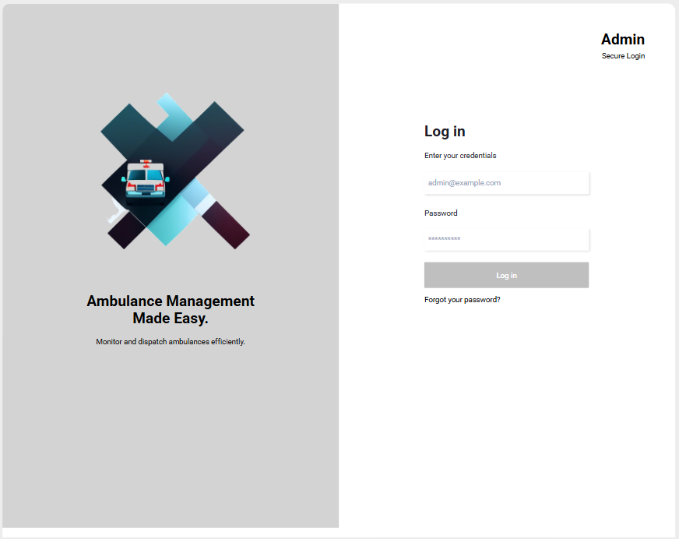
Demo (Website)
Preliminary Demo – Prototype Preview

Slide 15
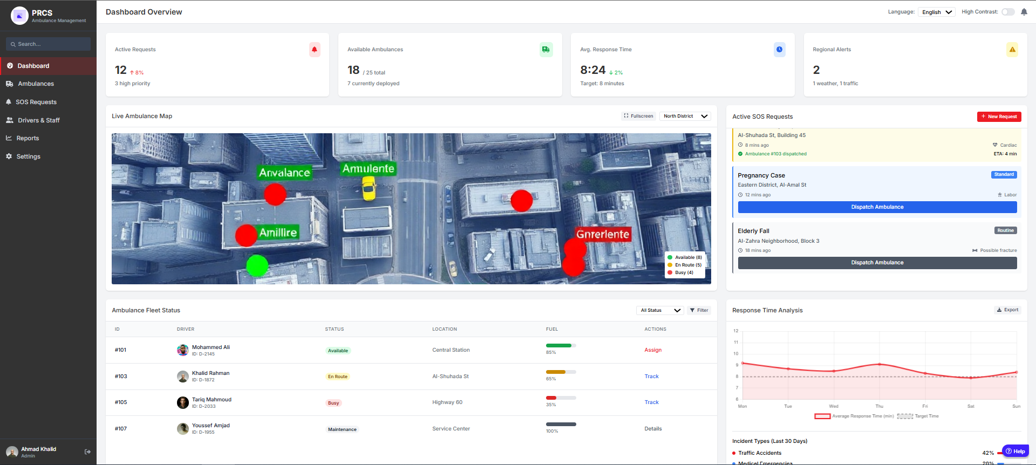
Demo (Website)
Preliminary Demo – Prototype Preview

Slide 16
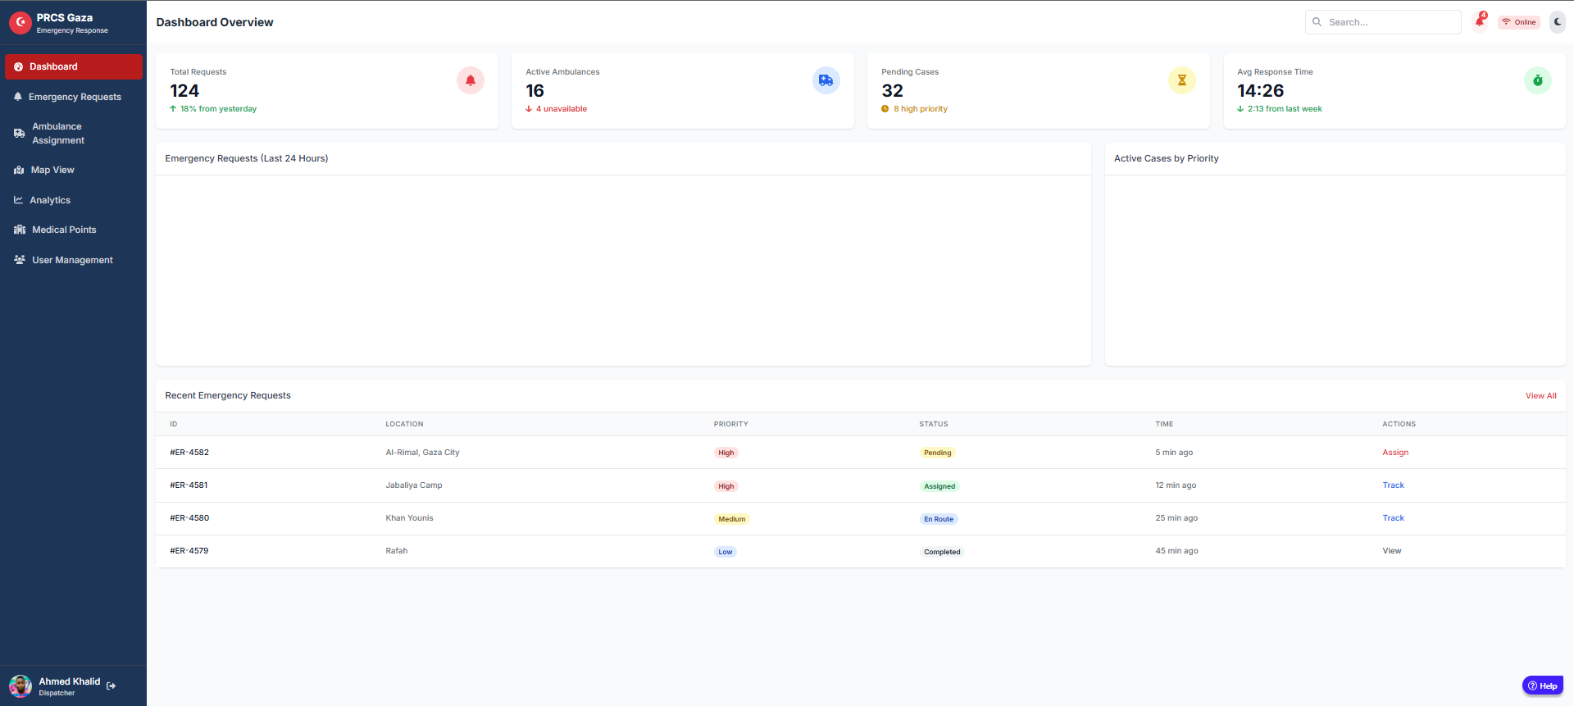
Demo (Website)
Preliminary Demo – Prototype Preview

Slide 17
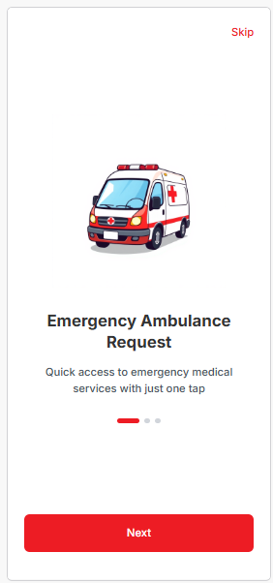
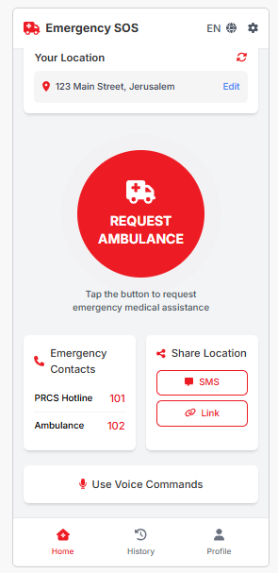
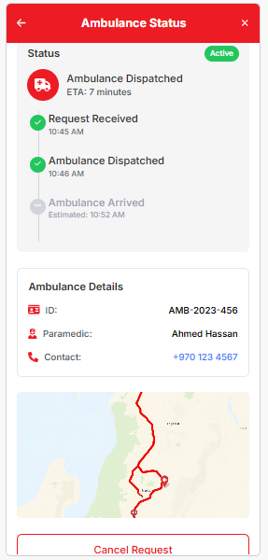
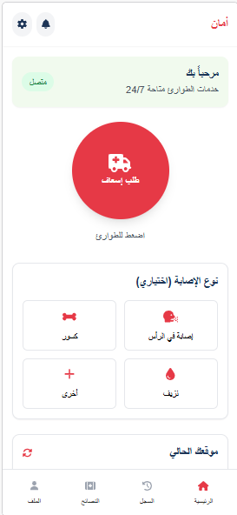
Demo (Mobile)
Preliminary Demo – Prototype Preview

Slide 18
Expected Performance After Implementation
50% decrease in average ambulance dispatch time
80% fewer missed requests due to manual errors
Real-time visibility into 100% of active emergencies

Slide 19
Conclusion & Call to Action
We invite the Palestine Red Crescent Society to:
Support a pilot run in selected zones
Provide feedback for real-world optimization
Work with us to expand Aman system across Gaza
Let’s build a smarter, faster, life-saving response system.

